Slide 1
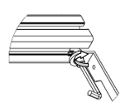
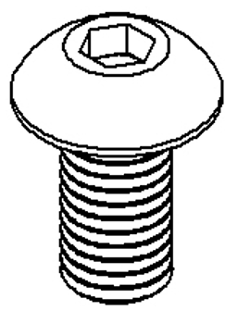

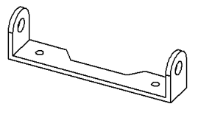

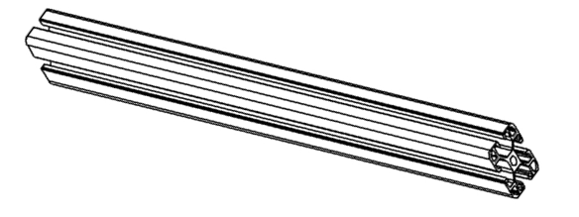

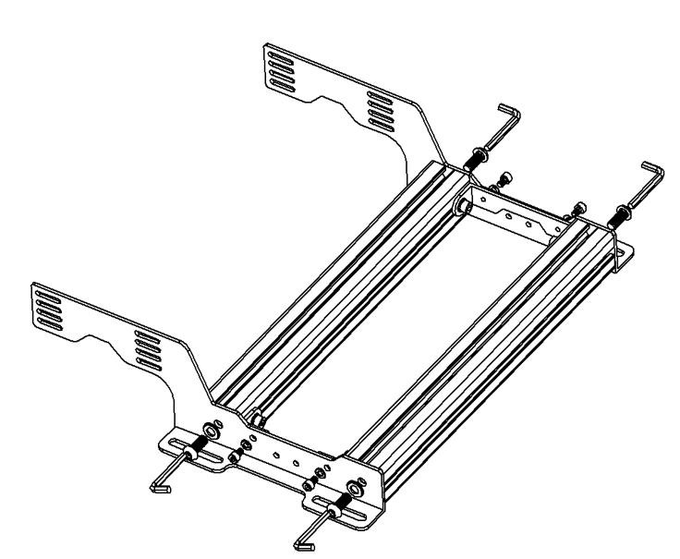
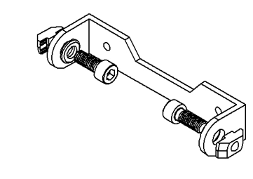

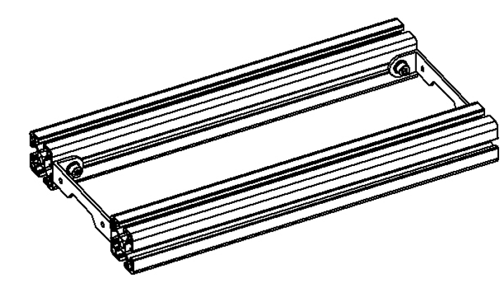
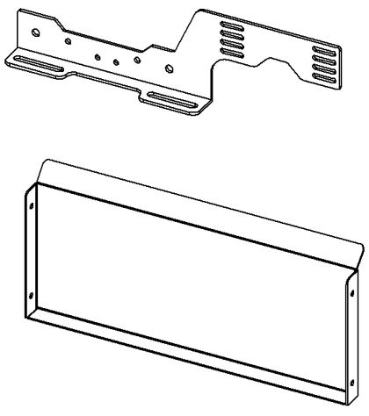

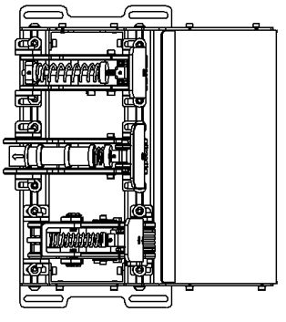
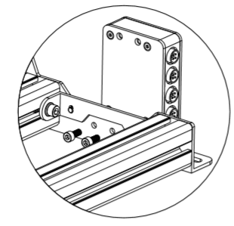
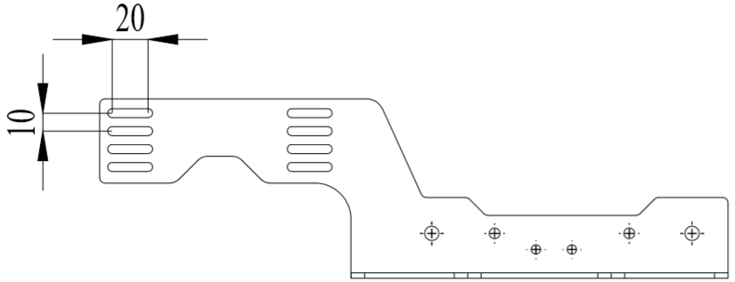
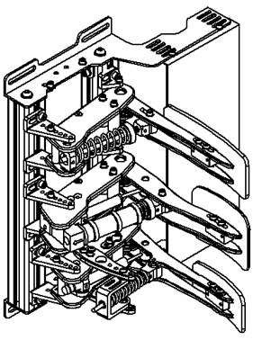

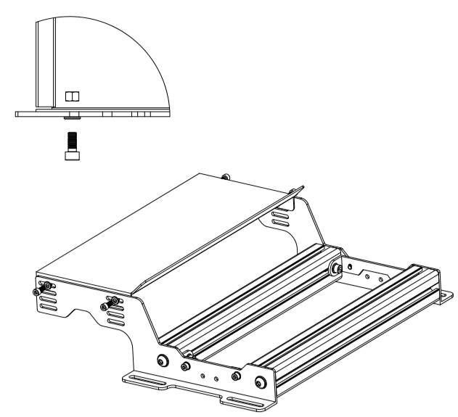



Parts needed to assemble the pedal tray and heel rest
Step 1: Put the bolts in the U bracket
Step 2: Install the U brackets on the aluminum profiles
Step 3: Install the heel rest holders on the aluminum profiles
Don’t tighten them yet, leave them loose for now.
X2
M8x20
M5x8
X2
M6x16
X2
X1
Step 7: Tighten the bolts with the included T nuts and washers
Step 6: Install your pedal units to the aluminum profile
Step 5: Install the controller box:
You can either install it on the left or right side of the pedal tray.
Step 4: Install the heel rest:
Choose the most comfortable height or recline for your seating position.
M6x16
M5x12
M5x12

